Slide 1
API Automation (RestSharp + Specflow)
Prasad SVS

Slide 2
REST
REST is acronym for REpresentational State Transfer
Its an architectural style for developing distributed systems and uses HTTP Protocol
REST architecture treats every content as a resource
Resources can be Text Files, Html Pages, Images, Videos or Dynamic Business Data
In REST architecture
REST Server simply provides access to resources
REST client accesses and modifies the resources
Each resource is identified by URIs

Slide 3
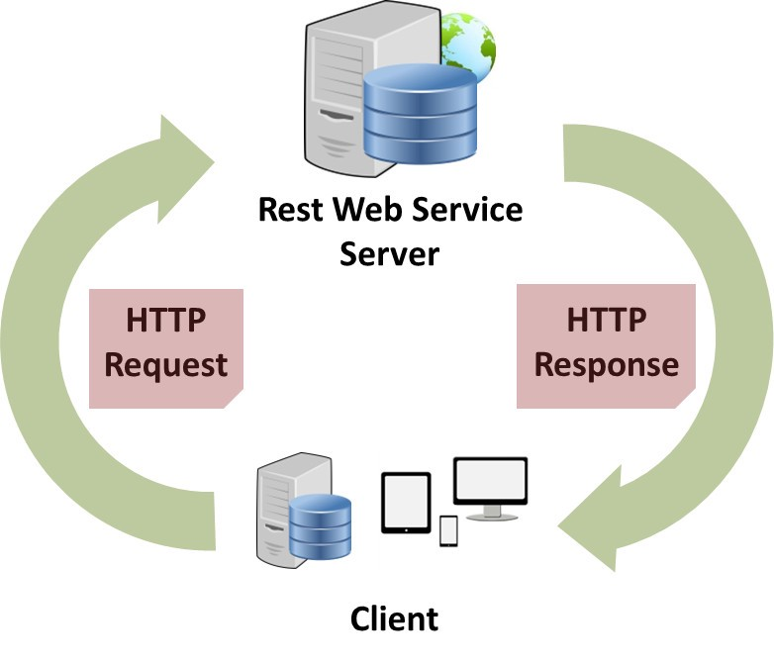

Slide 4
What is RestSharp ?
RestSharp is the most popular REST API client library for .NET
Main purpose of RestSharp is to make synchronous and asynchronous calls to remote resources over HTTP.
RestSharp can call any API over HTTP , as long as you have the resource URI and request parameters that you want to send.
RestSharp can take care of serializing the request body to JSON or XML and deserialize the response
RestSharp supports sending XML or JSON body as part of the request

Slide 5
Request
Querying the server for a resource or to perform CRUD operations
Request Methods
GET, POST, PUT, DELETE, PATCH,HEAD,OPTIONS,MERGE,COPY
Parameters Types
Cookies, GetOrPost ,HTTPHeader, UrlSegment, RequestBody, QueryString, QueryStringWithoutEncode ,
Add files
Add Decompression methods
Deflate, Gzip, None
Request Body
Json
XML

Slide 6
GET | The GET method is used to retrieve information from the given server using a given URI. Requests using GET should only retrieve data and should have no other effect on the data.
HEAD | Same as GET, but it transfers the status line and the header section only.
POST | A POST request is used to send data to the server, for example, customer information, file upload, etc. using HTML forms.
PUT | Replaces all the current representations of the target resource with the uploaded content.
DELETE | Removes all the current representations of the target resource given by URI.
OPTIONS | Describe the communication options for the target resource.

Slide 7
Response
Response is the information provided by the server for the resource requested by the client.
Informs the client that the action it requested has been carried out.
Content
Content Length , Content Encoding
Headers, Cookies
IsSuccessful, StatusCode, Status description, Response Status
Error Exceptions, Error messages
Request , URI , Server
Protocal Version , Raw Bytes and so on .

Slide 8
Client
Interface to execute requests on the server
Can set default values to
Headers
Cookies
Parameters
Base URL
Serializers

Slide 9
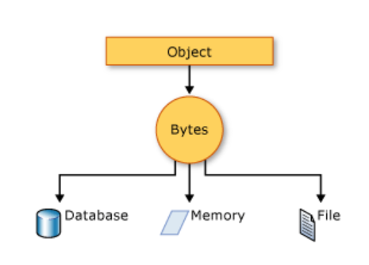
Serialization
Serialization is the process of bringing an object into a form that it can be written on stream.
It's the process of converting the object into a form so that it can be stored on a file, database, or memory or, it can be transferred across the network
Its main purpose is to save the state of the object so that it can be recreated when needed.
Serialization can be of 3 types
Binary serialization
Json Serialization
XML Serialization
Classes that need to be serialized should be attributed as Serializable

Slide 10
Deserialization
Deserialization is the process of getting back the serialized object so that it can be loaded into memory.
It resurrects the state of the object by setting properties, fields etc.
We read the content of the files , and convert them in to classes.

Slide 11
Hands on
Get Request
Post Request
Capturing responses
Adding Parameters
Serializing and Deserializing
https://jsonplaceholder.typicode.com/

Slide 12
Authenticators
RestSharp includes authenticators for
Basic HTTP (Authorization header),
NTLM (New Technology LAN Manager) and
Parameter-based systems
Simple Authenticator included allows you to pass username and password (or API and secret key) as GET or POST parameters depending on the method required
Snippet :
var client = new RestClient("http://example.com");
client.Authenticator = new SimpleAuthenticator("username", "foo", "password", "bar");
var request = new RestRequest("resource", Method.GET);
client.Execute(request);

Slide 13
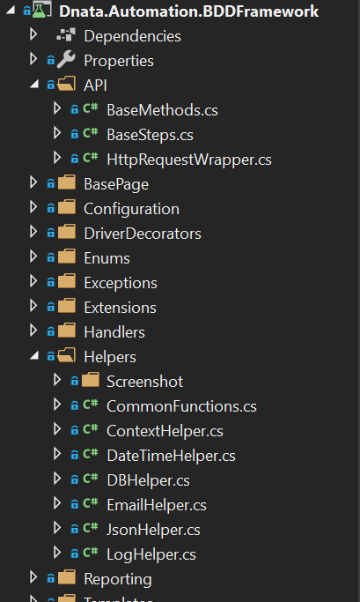
API in Framework
API
Base Methods
Base Steps
HttpRequestWrapper
Helpers
ContextHelper
JsonHelper
LogHelper

Slide 14
Base Methods
Common methods that an be used across projects
InitializeRequestForEndPoint(string resource )
T CreateRequestFromFile<T>()
Execute()
Execute<T>()

Slide 15
Base Steps
Common methods that can be used across all steps files
Storing and retrieving information into context
SaveRequestToContext() , GetRequestFromContext() , SaveResponseToContext(),GetResponseFromContext(), SaveResponseContentToContext(), GetResponseContentFromContext()
Response method
GetStatusCode(), GetStatusDescription(), GetServer(), GetResponseURI()

Slide 16
HttpRequestWrapper
HttpRequestWrapper is wrapper for IRestRequest class
It has all the methods required to add information to request
Cookies
Parameters
Headers
Request Body

Slide 17
Helpers
ContextHelper
It has methods that can be used to store and retrieve information from the context
JsonHelper
It has json that help to perform operation on Json files
LogHelper
It has methods required to log requests and response contents to console and report portal

Slide 18
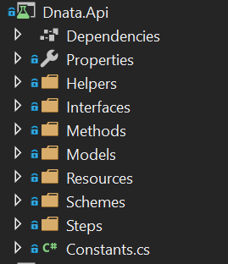
API Core Project

Slide 19
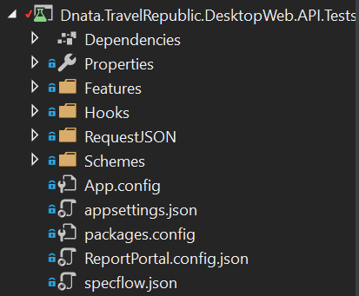
API Test Project

